Slide 1

Week 1: TmB basics
A simplest example

Slide 2
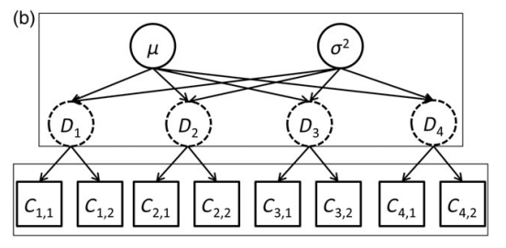
Hierarchical Models
Average density and variability among sites
Go by many names
Mixed effects model
Random effects model
State space model
Multi-level model
Density at 4 sites
Observed counts from 2 surveys at each site
The site densities are related (dependent)
The site densities are not directly observed (latent)
(Thorson and Minto 2014)

Slide 3
Statistical models used widely in ecology
A “conceptual and philosophical approach to doing science” with distinct models:
Observation: How data are observed (with error), given the process.
Process: Describes the dynamics of the ecological process (e.g. animal abundance over time/space)
P(data|process, parameters)*P(process|parameters)
These “latent states” lead to correlated residuals
E.g., densities sampled close together in space or time will be more similar than if far apart
This violates independence assumption of non-HM models (e.g., LM, GLM).
Hierarchical (mixed-effects) models are a generic solution in such situations
observation
process
Royle and Dorazio 2008, Thorson and Minto 2014

Slide 4
Random effects and fixed effects
Random effects = “parameters assumed to arise from a shared stochastic process”
Effects are fixed if they are interesting in themselves or random if there is interest in the underlying population rather than in testing the differences of values between particular levels.
Fixed effects are constant across individuals, and random effects vary.
Random effects are especially useful when we have (1) lots of levels (e.g., many species or blocks), (2) relatively little data on each level (although we need multiple samples from most of the levels), and (3) uneven sampling across levels.
Frequentists define random effects as categorical variables whose levels are chosen at random from a larger population, e.g., species chosen at random from a list of endemic species.
Bayesians define random effects as sets of variables whose parameters are [all] drawn from [the same] distribution. A fixed effect is one where we estimate each parameter (e.g., the mean for each species within a genus) independently (with independently specified priors).

Slide 5
Frequentist: Sampling is infinite and decision rules can be sharp. Data are a repeatable random sample - there is a frequency. Underlying parameters are fixed i.e. they remain constant during this repeatable sampling process.
Bayesian: Unknown quantities are treated probabilistically and the state of the world can always be updated. Data are observed from the realised sample. Parameters are unknown and described probabilistically. It is the data which are fixed.

Slide 6
State space model
Can differentiate between two distinct sources of variability: the biological or process variation (e.g., demographic stochasticity) and the measurement error associated with the sampling method
Become a general approach to account for multiple levels of stochasticity when modelling time-series

Slide 7
Linear model, GLM, GLMM
Linear models are a way of describing a response variable in terms of a linear combination of predictor variables. The response should be a continuous variable and be at least approximately normally distributed.
Generalized linear model is a flexible generalization of ordinary linear regression that allows for response variables that have error distribution models other than a normal distribution.
Generalized linear mixed model (GLMM) is an extension to the generalized linear model (GLM) in which the linear predictor contains random effects in addition to the usual fixed effects. They also inherit from GLMs the idea of extending linear mixed models to non-normal data.

Slide 8
Additive model, GAM
Additive model is a non-parametric (do not assume fixed model structure) regression model in which the systematic component is the arithmetic sum of the individual effects of the predictors.
Generalized additive model (GAM) is a generalized linear model in which the linear predictor depends linearly on unknown smooth functions of some predictor variables, and interest focuses on inference about these smooth functions.
blend properties of generalized linear models with additive models.

Slide 9
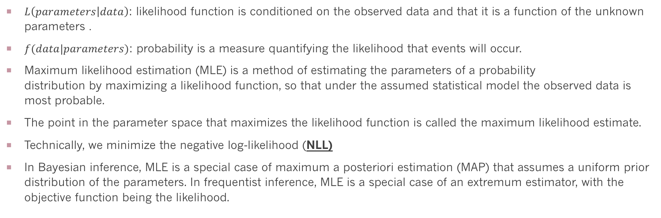
Likelihood function and maximum likelihood
$L\left(parameters | data\right)$: likelihood function is conditioned on the observed data and that it is a function of the unknown parameters .
$f(data|parameters)$: probability is a measure quantifying the likelihood that events will occur.
Maximum likelihood estimation (MLE) is a method of estimating the parameters of a probability distribution by maximizing a likelihood function, so that under the assumed statistical model the observed data is most probable.
The point in the parameter space that maximizes the likelihood function is called the maximum likelihood estimate.
Technically, we minimize the negative log-likelihood (NLL)
In Bayesian inference, MLE is a special case of maximum a posteriori estimation (MAP) that assumes a uniform prior distribution of the parameters. In frequentist inference, MLE is a special case of an extremum estimator, with the objective function being the likelihood.

Slide 10
Data Fitting
Data fitting is the process of fitting models to data and analyzing the accuracy of the fit.
Find the MLE.

Slide 11

Finding The Derivative: Function Minimization
With TMB we will do function minimization
To minimize a function f(x), it helps to be able to calculate the derivative, f’(x).
$$\frac{df}{dx}=f^{′}\left(x\right)=\lim_{h→0}{\frac{f\left(x+h\right)−f(x)}{h}}$$
If x is a vector, this is a “gradient”
At the minimum (or maximum) the derivative is 0.

Slide 12
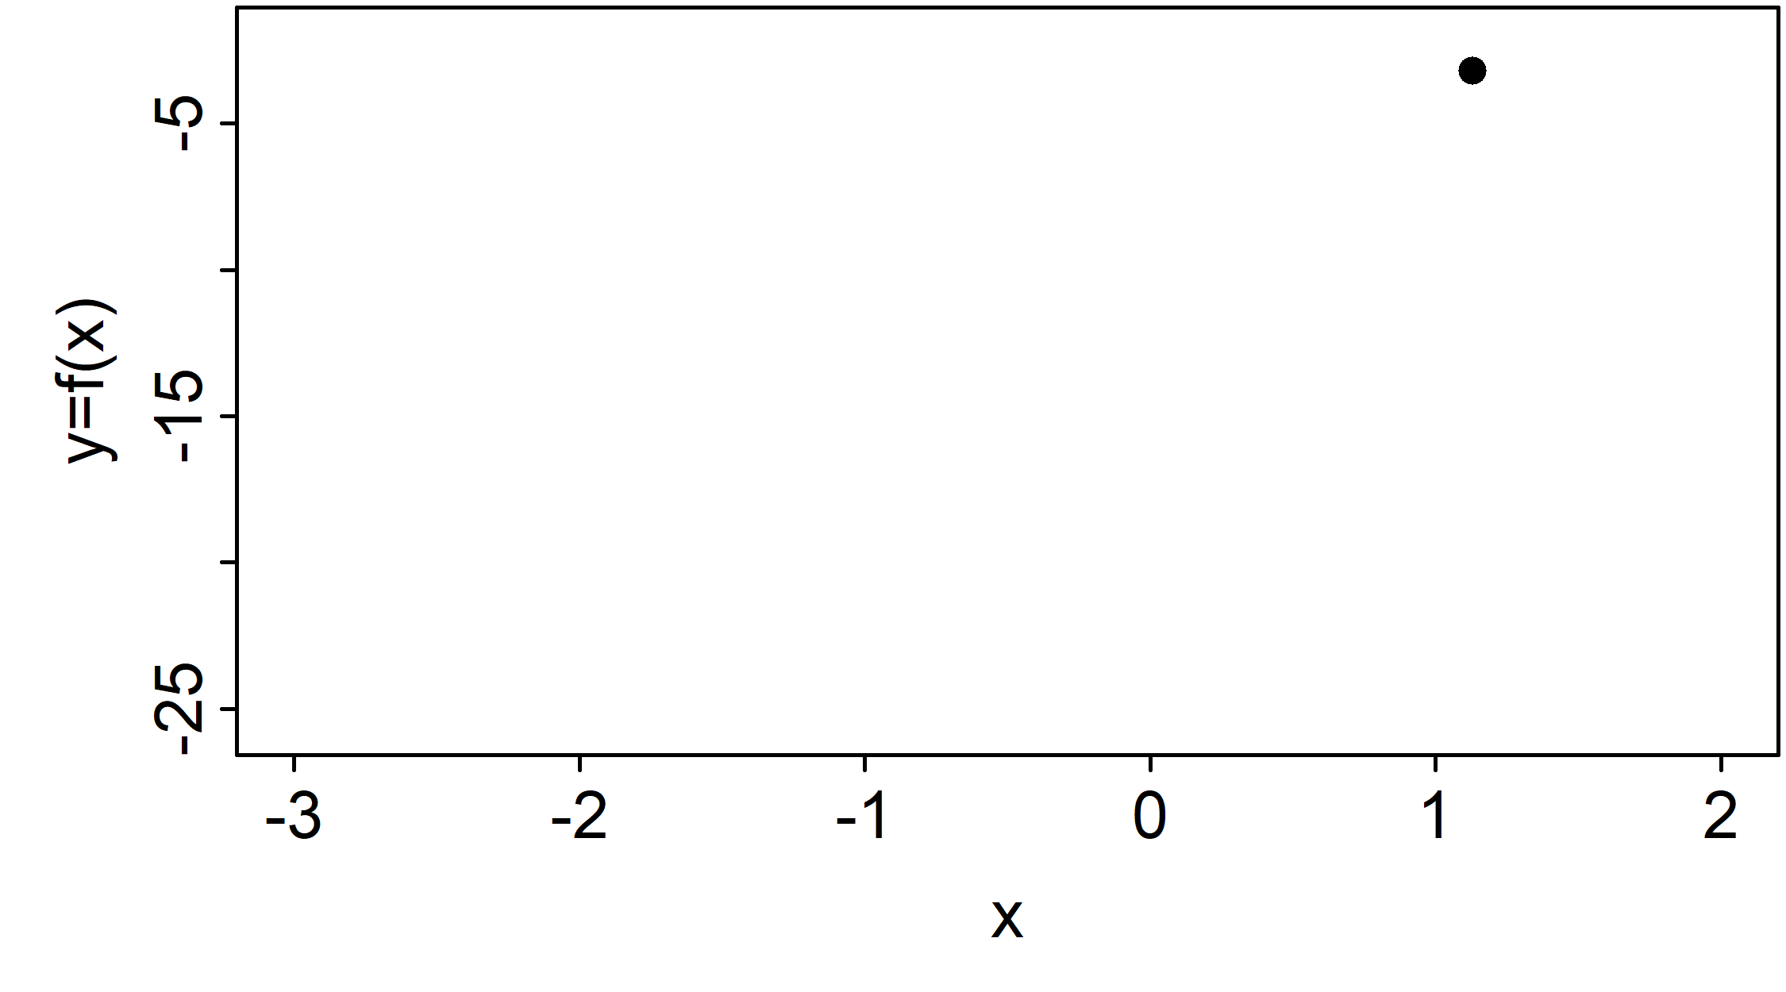
1D Function Minimization
Derivatives tell us which way is down
Iterate toward minimum until derivative is 0
This is known as numerical optimization

Slide 13
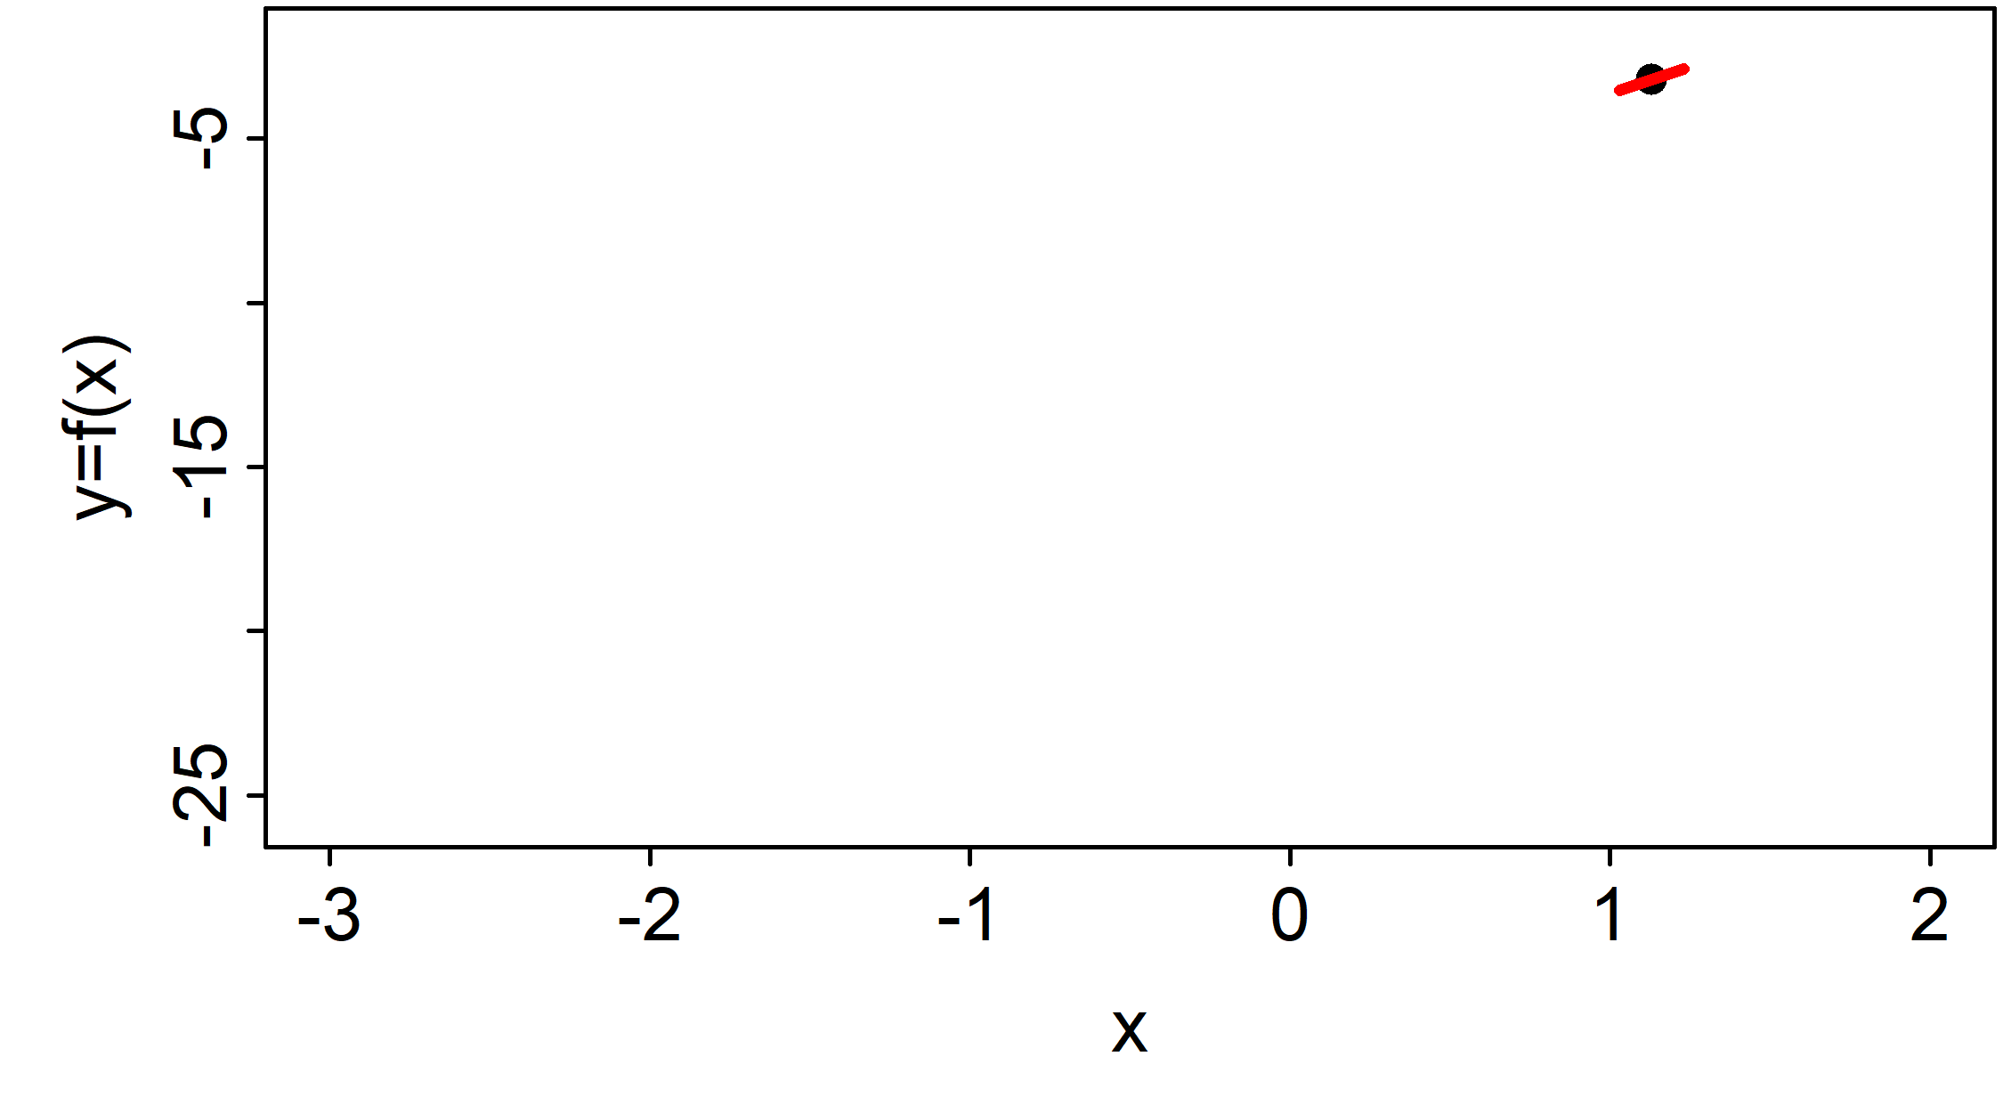
1D Function Minimization
Derivatives tell us which way is down
Iterate toward minimum until derivative is 0
This is known as numerical optimization

Slide 14
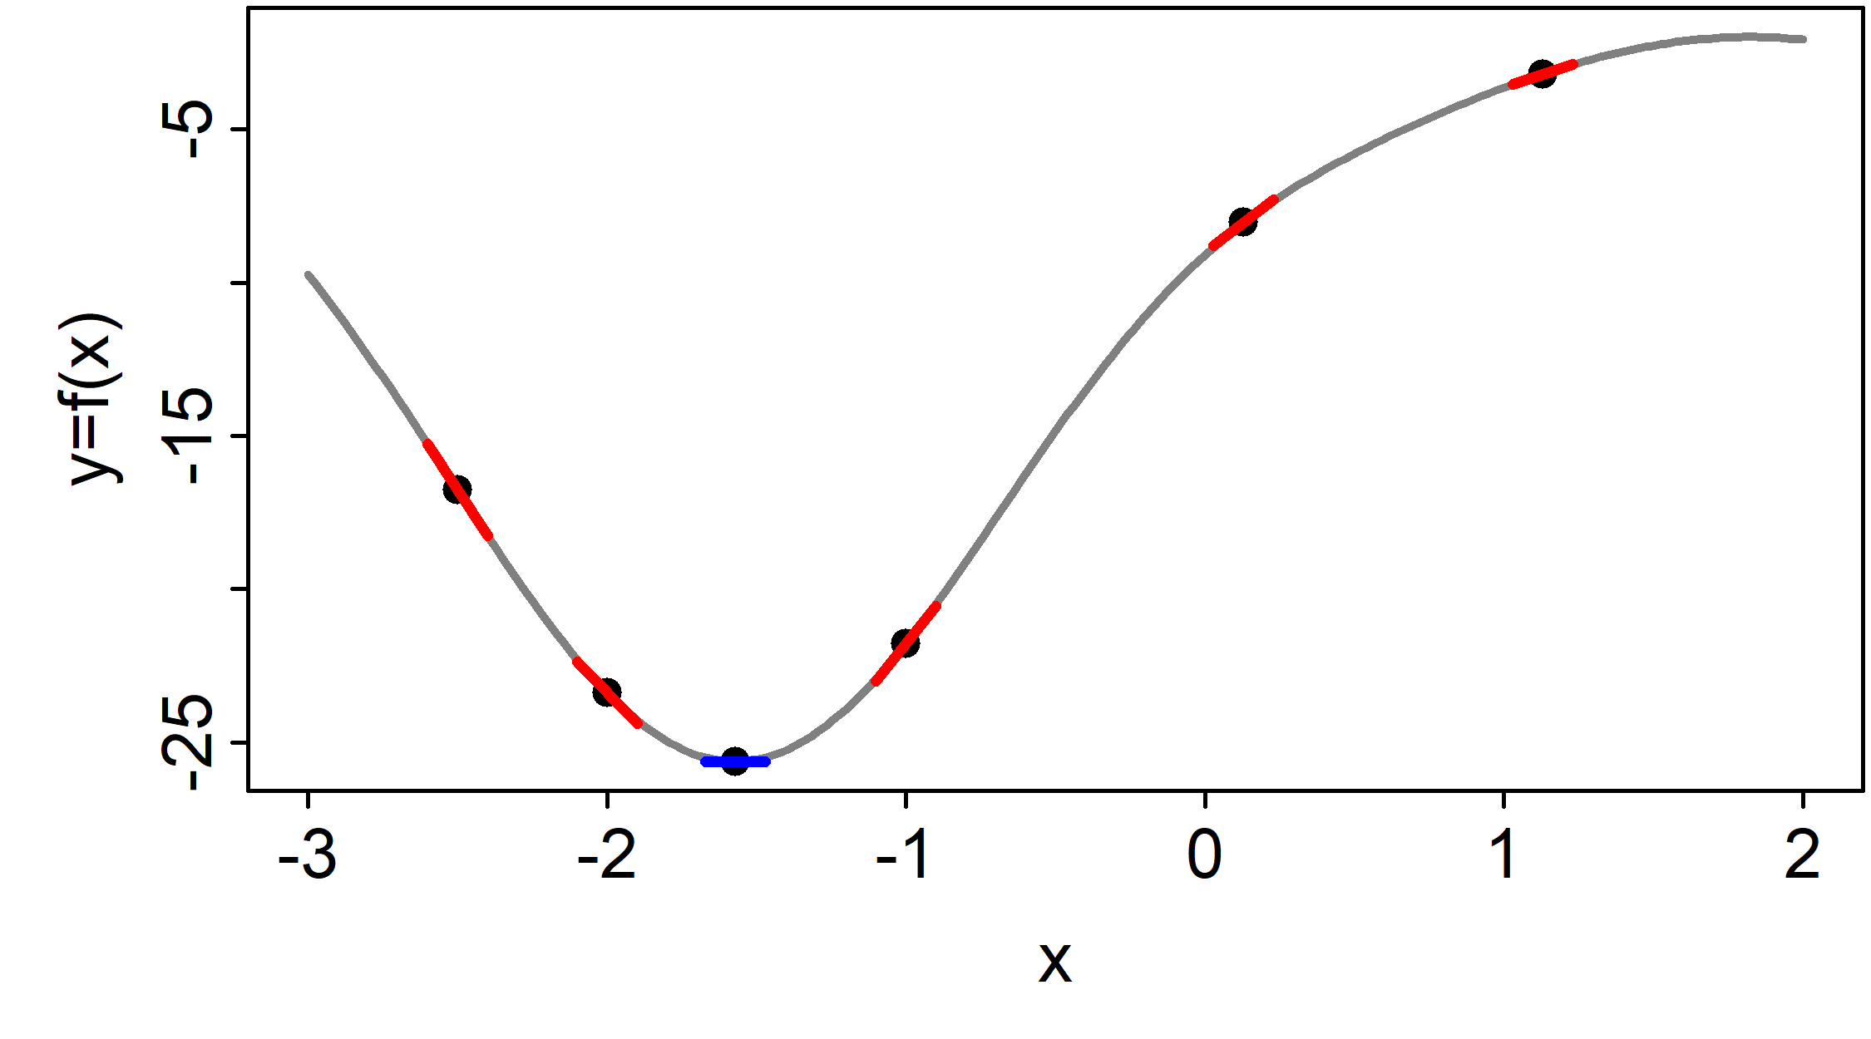
1D Function Minimization
Derivatives tell us which way is down
Iterate toward minimum until derivative is 0
This is known as numerical optimization

Slide 15
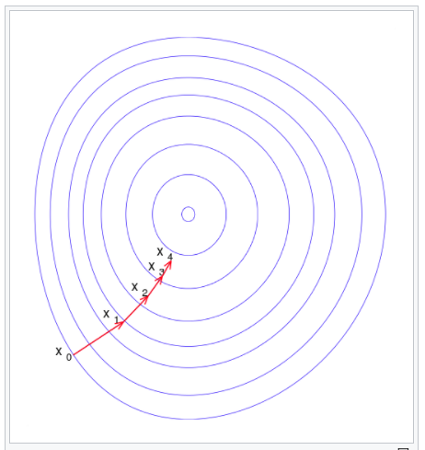
2D Function Minimization
Contours show level sets
(think of bowl)
Iterative steps toward minimum
Wikipedia.org

Slide 16
Calculating Derivatives
Analytical derivatives (i.e., a formula) are ideal, but difficult to find
Numerical derivatives like “finite difference” (e.g., set h=0.0001 in formula) are unreliable
So, how do we calculate gradients of complex functions (e.g., statistical models)?
Solution = “automatic differentiation”
For us, a magic trick the computer does to calculate fast and accurate gradients

Slide 17

Example: Normal likelihood
Probability (density):
$$Pr\left(x|μ,σ\right)=\frac{1}{\sqrt{2πσ^{2}}}e^{−\frac{{(x−μ)}^{2}}{2σ^{2}}}$$
Likelihood:
$$\operatorname{Pr}\left(x|μ,σ\right)=L\left(μ,σ|x\right)=\frac{1}{\sqrt{2πσ^{2}}}e^{−\frac{{(x−μ)}^{2}}{2σ^{2}}}$$
But calculated the same in R!
dnorm(x=2, mean=3, sd=1)

Slide 18

Example: Normal Likelihood
If independent, multiply data points together
$$L\left(x\right)=\prod_{i=1}^{n}{\frac{1}{\sqrt{2πσ^{2}}}e^{−\frac{{(y_{i}−μ_{i})}^{2}}{2σ^{2}}}}$$
Then taking the log:
$$logL\left(y\right)=−n∗log\left(\sqrt{2πσ^{2}}\right)−\sum_{i=1}^{n}{\frac{{(y_{i}−μ_{i})}^{2}}{2σ^{2}}}$$
More simply (and recommended) is to use dnorm:
loglike <- sum(dnorm(x, mu, sd, log=TRUE))
Sum of squares

Slide 19
Example: Normal likelihood
μ is the expected value, a function of parameters
The “MLE” is the set of parameters which maximize the likelihood of the data
Constants have no effect on optimization, but often best to leave them in
Same ideas for other likelihoods (Poisson, binomial, etc.)

Slide 20
Exercise: Poisson Likelihood
Look up the probability mass function (pmf)
Identify which terms are data and parameters
Take log by hand and write out R function to calculate log-likelihood for single data point
Evaluate for k=4 and lambda=5.5
Check answer with dpois(x, lambda, TRUE)
Plot NLL for lambda between 0 and 15
[Hint: Use log(factorial(k)) or lgamma(k+1)]

Slide 21
Fitting MLE models: basics
Goal: find the parameters that minimize the NLL
Usually need to use numerical optimization
These algorithms try to move “down” until minimum is attained (gradients are zero)
Need to specify starting value that is reasonable
Need to be careful to constrain parameters appropriately (e.g., σ>0; 0<p<1) with transformations

Slide 22

What is TMB?
TMB is an R package and environment for fitting statistical models
Designed specifically for large, complex hierarchical models
Uses marginal maximum likelihood inference
Capable of Bayesian inference
TMB has a superpower: calculus!
Calculus!!
www.vix.com

Slide 23
TMB
Linear Hierarchical Models
[R + lme4]
Generalized Additive Models
[R mgcv/gam/gamlss]
Linear and Generalized Linear Models
[R]
Timeseries
[R + ??]
Fisheries stock assessment
[ADMB/Fortran]
Geospatial / Spatiotemporal
Models
[ArcGIS/INLA]
Mark-recapture
[JAGS/MARK]
Generic Bayesian
[JAGS/Stan]

Slide 24
Fitting MLE models: details
Algorithm approaches minimum but may never achieve it
Thus, “convergence” = sufficiently close to global minimum
Typically when maximum gradient is <0.0001
Warning: Can get “stuck” in local minima (bad!)
Test: multiple initializations arrive at same MLE
You are responsible for assuring convergence!

Slide 25
Optimizers in R
R offers many numerical optimizers with different advantages/disadvantages
We will use nlminb but can also use optim
Allows use of box constraints (more later)
We pass it a NLL function, it gives us the parameters that minimize it
Reminder: accurate gradients really improve optimizer performance

Slide 26
Example: Linear model
We will use a simple linear model to demonstrate optimization
We will fit the model three ways:
Using the lm function in R
Using R optimizer with R NLL
Using R optimizer with TMB NLL
The goal is to introduce some key concepts and get practice with TMB

Slide 27
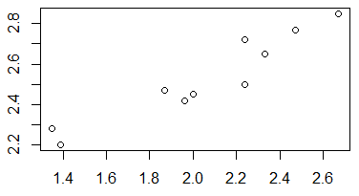
Linear model 1
x <- c(1.87, 1.96, 1.39, 2.24, 2.33, 2.24, 2.67, 2.47,
1.35, 2.00)
y <- c(2.47, 2.42, 2.2, 2.72, 2.65, 2.5, 2.85, 2.77,
2.28, 2.45)
We assume model: $y=intercept+slope∗x$
lm(y~x)

Slide 28
Linear model 2: by hand
nll <- function(pars){
intercept <- pars[1]
slope <- pars[2]
sd <- exp(pars[3])
## Predict y given parameters
mu <- intercept + slope*x
## Calculate log-likelihood
nll <-
-sum(dnorm(y, mu, sd, log=T))
return(nll)
}
fit.R <-
nlminb(start=pars, objective=nll)
R function that
Inputs parameters
Returns NLL
Need to explicitly model variance term
Note the use of exp() to keep it positive
We don’t have a gradient function

Slide 29
Linear model 3: with TMB
TMB looks similar to R
We have a gradient function!
[Look through TMB code]
… TMB code:
<ignore other code for now>
vector<Type> mu(y.size());
mu=intercept+slope*x;
nll=-sum(dnorm(y, mu, sd, true));
return nll;
…
fit.tmb <- nlminb(start=pars,
objective=obj$fn,
gradient=obj$gr)

Slide 30
Linear model comparisons
nlminb returns a list with elements:
Optimal parameters (par)
Minimum NLL (objective)
Convergence status (0=converged)
How many steps it took (iterations)
# of times it used the function (evaluations)
> fit.R
$par
[1] 1.5774 0.4647 -2.735
$objective
[1] -13.16127
$convergence
[1] 0
$iterations
[1] 13
$evaluations
function gradient
22 48
Finite difference

Slide 31
Linear model comparisons
TMB prints the maximum gradient component (mgc) at each iteration (step)
Getting smaller and smaller
What happens if we evaluate the gradient function at the MLE?
Note: R has no idea it is using TMB!
>fit.tmb <- nlminb(start=pars,
objective=obj$fn, gradient=obj$gr)
outer mgc: 99.40139
outer mgc: 5.990303
outer mgc: 132.3652
outer mgc: 108.0497
outer mgc: 4.673943
…
outer mgc: 0.1184033
outer mgc: 0.005721744
outer mgc: 0.0002056732
outer mgc: 1.404738e-05

Slide 32
What about the variance term?
R shows the variance estimate in the summary()
Residual standard error: 0.07255
Does this match our MLE?
> exp(fit.tmb$par[3]) [1] 0.06488976
No! lm does not use maximum likelihood to estimate the variance!!
It uses Restricted Maximum Likelihood (REML) which is better in this case (we will do this with TMB later)
Remember: MLEs can be biased (and are for variances)

Slide 33
Review of key concepts
To “fit” statistical models we minimize the –log-likelihood to find the MLE
We often minimize the NLL numerically
Optimization is better with gradients, and TMB calculates those easily
We use exp() to keep parameters positive
The MLE variance is biased

